Slide 1
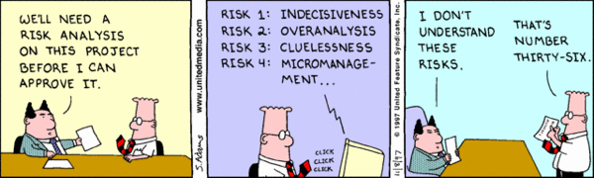
SQL StreamStore
Euricom .NET Cruise 2018
Gerben Schepers
“SQL Stream Store is a .NET library to assist with developing applications that use event sourcing or wish to use stream based patterns over a relational database and existing operational infrastructure.”

Slide 2
Agenda
A word on Events / Streams
SQL Stream store
Configuration
Write
Read
Snapshots
Subscriptions
Limitations
Alternatives

Slide 3

SQL Stream Store
“SQL Stream Store is a .NET library to assist with developing applications that use event sourcing or wish to use stream based patterns over a relational database and existing operational infrastructure.”
Notes:
Sql stream store is zo’n tool. Het is een library
SQLStreamStore / relational databases will never be be as fast as custom stream / event based databases (e.g EventStore, Kafka). For DDD applications (aka "collaborative domains") that would otherwise use a traditional RDBMS databases (and ORMs) it should perform within expectations.
Maar ook postgressql

Slide 4
ES vs streaming
Enterprises
Biggest problem:
compexity of domain
➔ Business logic
Internet companies
Biggest problem:
volume of data
➔ complexity of data infrastructure
Event Sourcing
Stream Processing
Source: martin kleppmann on event-sourcing-stream-processing-at-ddd-europe

Slide 5
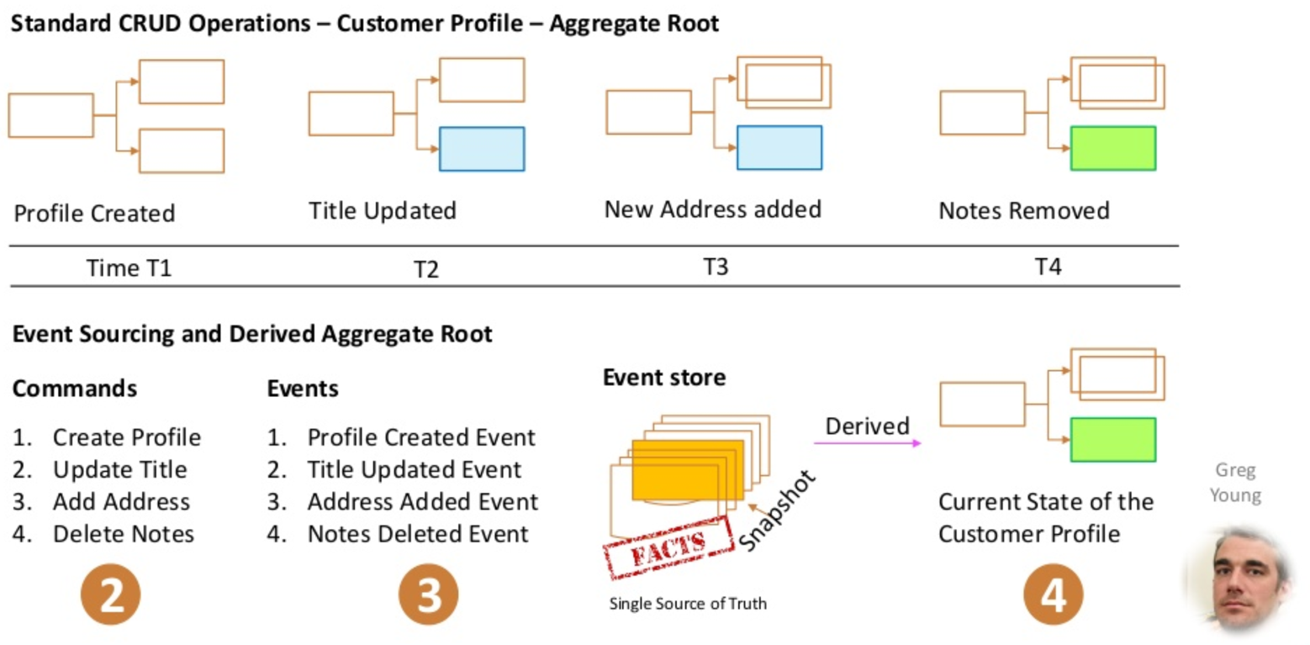
What is EventSourcing
Source: Event Storming and Saga - Araf Karsh Hamid

Slide 6
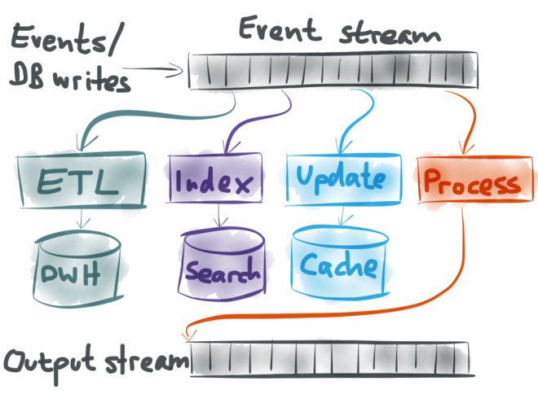
Use cases of event streams
Notes:
You can take all the raw events, perhaps transform them a bit, and load them into a big data warehouse where analysts can query the data to their heart’s content.
You can update full-text search indexes, so that when a user hits the search box, they are searching an up-to-date version of the data.
You can invalidate or refill any caches, so that reads can be served from fast caches while also making sure that the data in the cache remains fresh.
And finally, you can even take one event stream, and process it in some way (perhaps joining a few streams together) to create a new output stream. This way, you can plug the output of one system into the input of another system. This is a very powerful way of building complex applications cleanly.

Slide 7
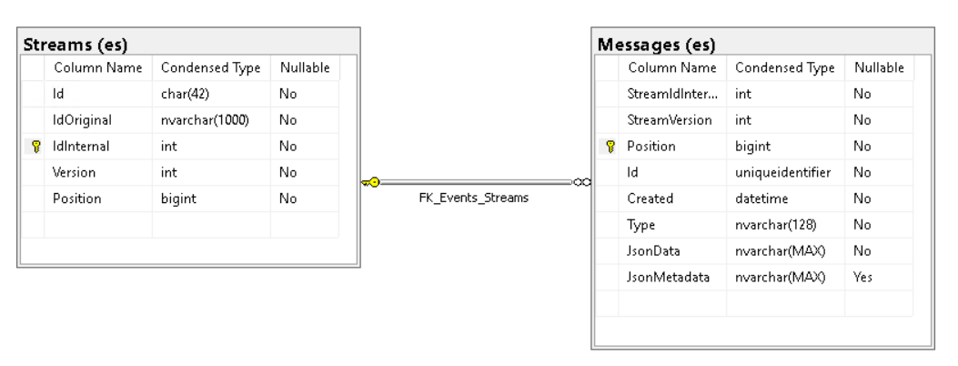
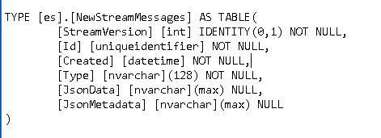
MSSql DB Model
Notes:
The Streams table contains the collection of unique streams in the store. As stream Ids are strings there are a number of optimisations applied:
The original stream Id is stored in column IdOriginal and limited to 1000 characters.
Position of
When a stream is appended for first time is it checked to see if it is parsable as a Guid. If so, then that is stored in the Id column. If not then a Sha1 hash of the Id is generated and used. This helps with stream lookups and the Id unique index constraint.
An IdInternal identity column is used for joins with the messages table.
Each new message increases the message position, the StreamVersion is increased for the stream.
Sql user-defined-table type (to send multiple rows of data to a Transact-SQL statement)

Slide 8
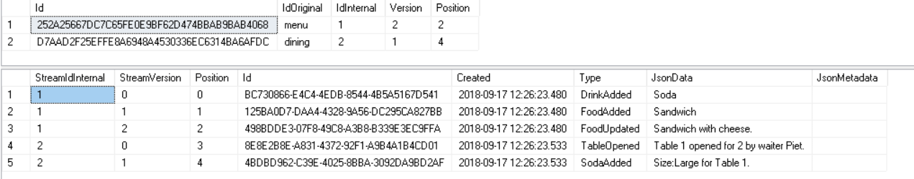
Sample data
SELECT * FROM [es].[Streams]
SELECT * FROM [es].[Messages]

Slide 9
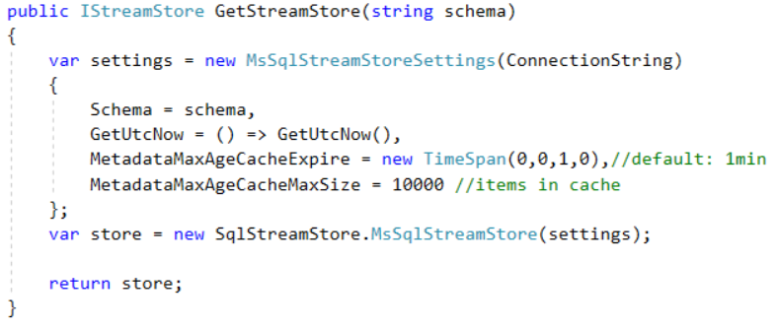
Configure a store
Notes:
GetUtcNow: Represents an operation to get the UTC data time. Mainly used in tests to control the temporal concerns.
To help with perf, the max age of messages in a stream are cached. It is not expected that a streams max age metadata to be changed frequently.
CacheExpire: hold on to the max age for the specified timespan. The default is 1 minute.
CacheMaxSize: define how many items are cached. The default value is 10000.

Slide 10
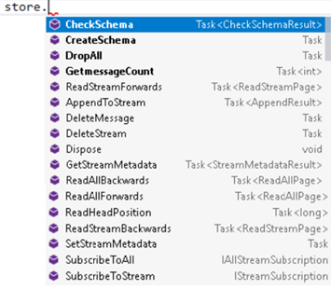
Store Api
Configuration
CheckSchema (only on MSSQL)
CreateSchema (only on MSSQL)
DropAll (only on MSSQL)
GetStreamMetadata
SetStreamMetadata
Reads
Forward / Backward
ReadSingleStream / ReadAllStreams
HeadPosition
GetmessageCount (only on MSSQL)
Writes
AppendToStream
Deletes
DeleteMessage
DeleteStream
Subscriptions
SubscribeToAll
SubscribeToStream

Slide 11
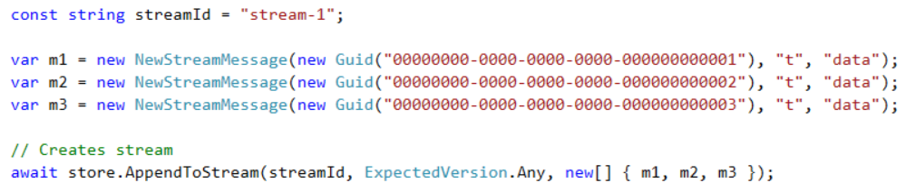
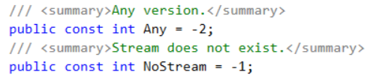
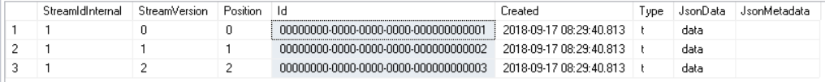
Write messages to a stream
Streams
Messages
Notes:
The streamId is a value object that wraps a string ensuring non-null and no whitespace. StreamIds lengths should not exceed the limits set by underlying store.
The expectedVersion parameter is used for concurrency checking. You can supply a specific that you expect the stream to be at and if the stream is at a different version, a WrongExpectedVersionException is thrown. Alternatively you can supply ExpectedVersion.Any if you don't care what the current stream version is (including if it doesn't yet exist) or ExpectedVersion.NoStream if you explicitly expect it to not yet exist.
The message parameter defines the collection of messages that are appended in a transaction. If empty or null then the call is effectively a no-op.
AppendResult return value contains two properties, CurrentVersion and CurrentPosition. This is useful to return to callers if they need to subsequently load a projection to help with reading their own writes.
With a specific expected` If the collection of messages have been previously written in the same order they appear in the append request starting at the expected version no new messages are written
Idempotent appends is when a stream append operation occurs multiple times but the messages are appended once. This is useful for retry / resume type of operations.
When appending messages, the MessageId of NewStreamMessage, coupled with the expectedVersion, determines the idempotency policy applied.

Slide 12

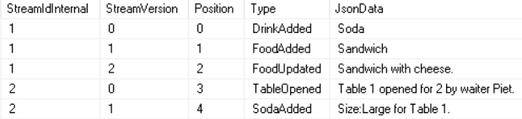
Version vs Position
Streams
Messages
Version is incremented per stream
Position is incremented per message

Slide 13
Reads
ReadStreamForward (streamId, fromVersion, count, prefetchJsonData)
ReadStreamBackward (streamId, fromVersion, count, prefetchJsonData)
ReadAllForward (fromPosition, count, prefetchJsonData)
ReadAllBackward (fromPosition, count, prefetchJsonData)
ReadHeadPosition (the position of the very latest message))

Slide 14
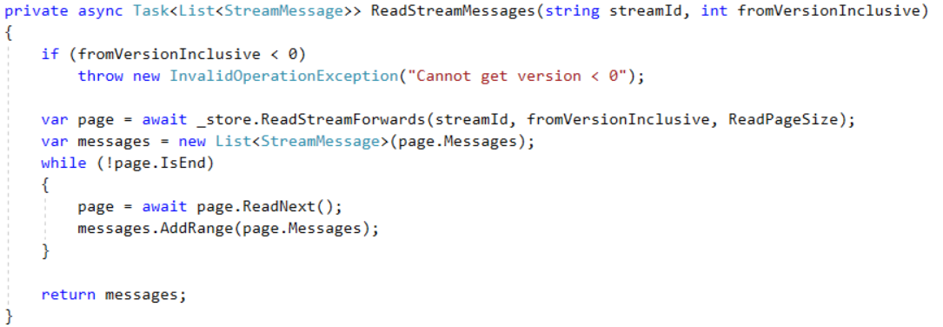
Sample - read all messages from a stream
eg. 20

Slide 15
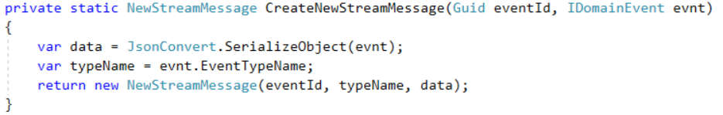
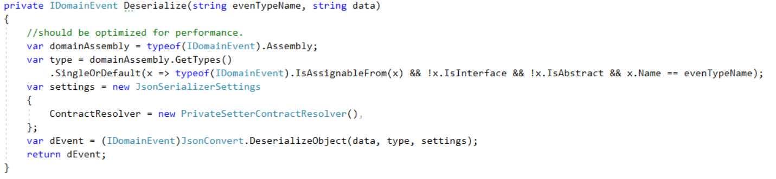
Message (De)Serializing
Serialization: use json.net and save the classname (not FQDN) as the type in the message
Deserialization: lookup the types (using registry of types or by reflection) based
Use PrivateSetterContractResolver so your events can be made immutable.

Slide 16
Weak schema versioning (Greg Young Versioning book)
Exists on json and instance → value from json
Exists on json but not on instance → No Operation
Exists on instance but not in json → default value
Never change the meaning of a field
Nothing can be renamed

Slide 17
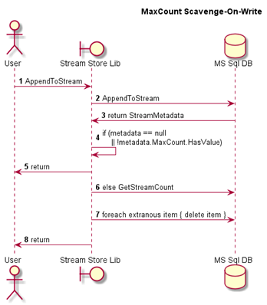
Metadata on a stream
You can set metadata on a stream to improve performance.
MaxAge in seconds:
The max age of messages in a stream
Limits the amount of messages read
MaxCount:
The maximum amount of messages in a stream
Messages will be deleted on write
Not cfr EventSourcing because you cannot rebuild current state if not all events are stored.
But useful for pure stream cases where only the same kind of data is added:
eg. keep 1 year history of audit log
Notes:
This is in contrast with a real eventstore. Events will not be deleted and you need to use a snapshot to limit the amount of events that are read.

Slide 18
Snapshots / memento
Why?
You use CQRS, streams and (optionally) projections.
The model doesn't care about domain events (or "business decisions"). The intermediate / final states are the only interesting things.
You want to retain some or all previous versions.
You want the option to execute a query against your memento backed object without needing a projection.
How?
Store the memento as the message itself in a stream.
Stream metadata decides how many previous copies to retain.
Loading a memento is reading stream backwards by one message only so rehydrating the corresponding object is fast.
Use cases
User settings, system configuration, documents etc.
Data coming from external systems where they are the source of truth.
Snapshots for streams that are (domain) event based.
It's a bit like a key-value store with versions

Slide 19
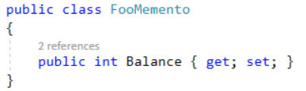
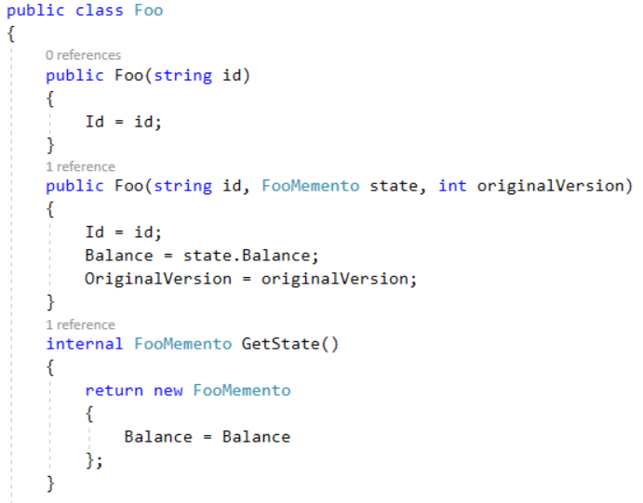
Memento implementation
“Memento” class that contains the state
create entity using the memento state
create memento object with entity state

Slide 20
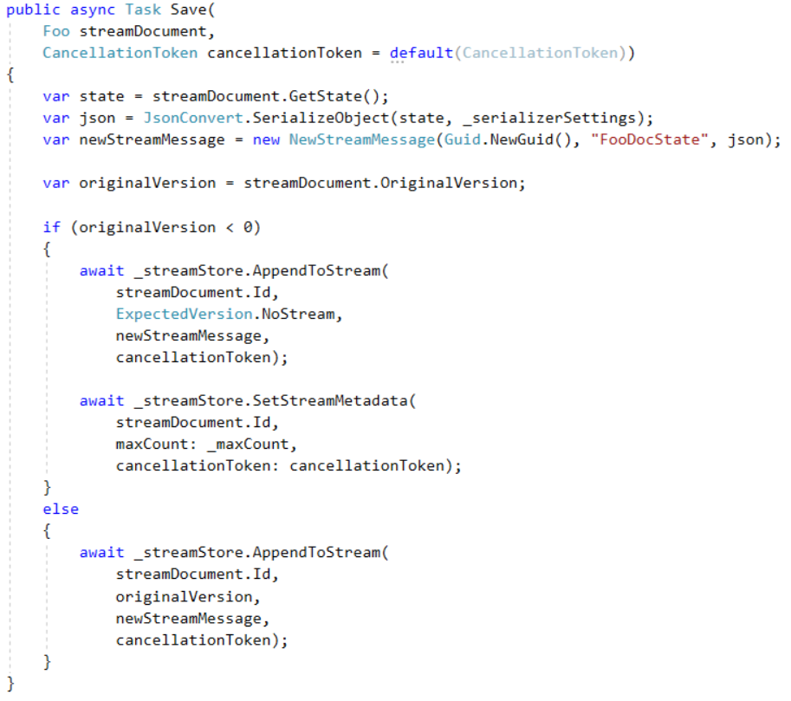
MementoRepository - Save
1. get memento state
2. check if new message
3. write new message
3. (bis) set maxCount for stream (eg. 10)

Slide 21
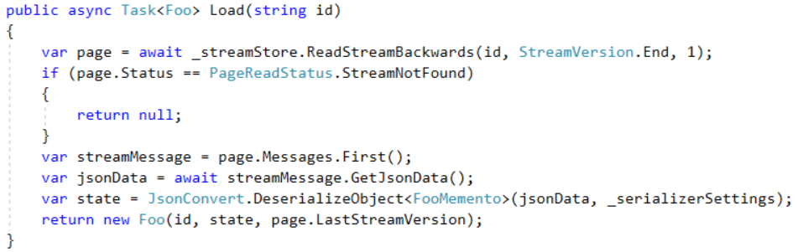
MementoRepository - Load
1. get last message of stream
2. deserialize the message
3. create the entity and pass the memento object

Slide 22
Subscriptions
SubscribeToStream
provide streamid
provide Version
SubscribeToAll
provide Position
3 delegates can be provided:
messageReceived (raised when a message is being pushed)
subscriptionDropped (raised on internal error and on subscriber processing error)
hasCaughtUp (contains a boolean that is true when caught up, otherwise false)

Slide 23
Limitations
SQLStreamStore / relational databases will never be as fast as custom stream / event based databases (eg. EventStore, Kafka). For DDD applications (aka "collaborative domains") that would otherwise use a traditional RDBMS databases (and ORMs) it should perform within expectations.
Subscriptions (and thus projections) are eventually consistent and always will be
Message metadata payloads are strings only and expected to be JSON format
No support for ambient System.Transaction scopes enforcing the concept of the stream as the consistency and transactional boundary.

Slide 24
What else do you need for a robust application?
Projection library
Projac (simple sql based projections)
LiquidProjections
Bus / Queue to process incoming events
Event / command handler / dispatcher
eg Mediatr
Retry, Circuit Breaker, Timeout, Bulkhead Isolation, and Fallback mechanisms for sending Integration Events
eg Polly

Slide 25
Alternatives
Own implementation (“event table”)
very simple case, no other features needed
Marten
Is a persistence library for .NET that provide document db functionality on top of a PostgreSQL database.
support for projections to create "read side" views of the raw event data
SqlStream
is a platform on top of S-Server to create complex streaming applications that can process up to millions of events/sec/core with millisecond latency.
EventStore
is a full blown database server + Complex Event Processing (CEP) Engine
is much more suited to handling streams with high volume of data
Notes:
With CEP, you write queries or rules that match certain patterns in the events. They are comparable to SQL queries (which describe what results you want to return from a database), except that the CEP engine continually searches the stream for sets of events that match the query and notifies you (generates a “complex event”) whenever a match is found. This is useful for fraud detection or monitoring business processes, for example.
S-Server: Streaming SQL engine: ANSI SQL+Java

Slide 26
Other Alternatives
Akka.NET
Akka is a toolkit for building highly concurrent, distributed, and resilient message-driven applications
Service Fabric
is a distributed systems platform that makes it easy to package, deploy, and manage scalable and reliable microservices and containers.
Apache Kafka
is a message broker, like a publish-subscribe message queue, which supports event streams with many millions of messages per second, durably stored on disk and replicated across multiple machines.
Notes:
Actor frameworks such as Akka and Service Fabric are also based on streams of immutable events. However, they are primarily a mechanism for concurrency, less a mechanism for data management. They have a distributed component, so you could build a distributed stream processing framework on top of actors. However, it’s worth looking carefully at the fault-tolerance guarantees and failure modes of these systems: many don’t provide durability, for example.
The principle it’s built on is very simple, he compares with an append only log file where new messages or events are appended. This creates an ordered sequence of records that in general can handle any streams of events. A significant feature of Kafka is its capability of handling events at very high volumes when distributed over multiple servers.

Slide 27
References
SQLStreamStore
https://sqlstreamstore.readthedocs.io/en/latest/
https://github.com/SQLStreamStore/SQLStreamStore
Projections
https://github.com/BitTacklr/Projac
https://github.com/liquidprojections/LiquidProjections
DDD – ES
https://martinfowler.com/bliki/BoundedContext.html
https://medium.com/@zimareff/ddd-all-the-things-b075be2107dc
https://www.confluent.io/blog/making-sense-of-stream-processing/
https://medium.com/plexiti/aggregates-and-sagas-are-process-owners-e8c8ba973da7
Other
http://martin.kleppmann.com/2016/01/29/event-sourcing-stream-processing-at-ddd-europe.html
https://sqlstream.com/

Slide 28
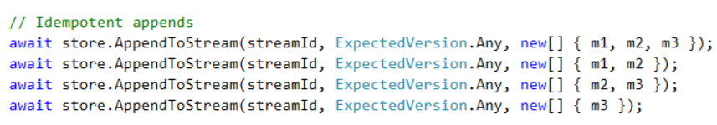
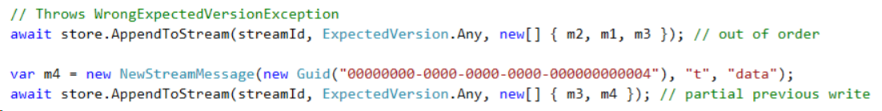
Write messages to a stream
Streams
Messages
Notes:
The streamId is a value object that wraps a string ensuring non-null and no whitespace. StreamIds lengths should not exceed the limits set by underlying store.
The expectedVersion parameter is used for concurrency checking. You can supply a specific that you expect the stream to be at and if the stream is at a different version, a WrongExpectedVersionException is thrown. Alternatively you can supply ExpectedVersion.Any if you don't care what the current stream version is (including if it doesn't yet exist) or ExpectedVersion.NoStream if you explicitly expect it to not yet exist.
The message parameter defines the collection of messages that are appended in a transaction. If empty or null then the call is effectively a no-op.
AppendResult return value contains two properties, CurrentVersion and CurrentPosition. This is useful to return to callers if they need to subsequently load a projection to help with reading their own writes.
With a specific expected` If the collection of messages have been previously written in the same order they appear in the append request starting at the expected version no new messages are written
Idempotent appends is when a stream append operation occurs multiple times but the messages are appended once. This is useful for retry / resume type of operations.
When appending messages, the MessageId of NewStreamMessage, coupled with the expectedVersion, determines the idempotency policy applied.

Slide 29
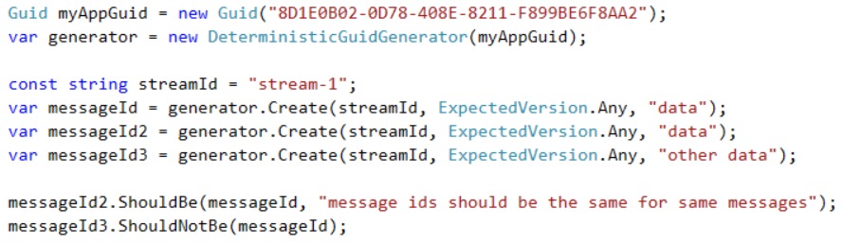
Deterministic Message ID Generation
Not stored in db
Only used to create other guids
Notes:
In order to leverage idempotent appends the message IDs should be the same for identical messages. SQLStreamStore ships with a helper class DeterministicGuidGenerator that can create GUIDs based on the message and stream it is being appended to. When creating a determinisitic generator you are required to supply a unique namespace that prevents other generators creating the same GUIDs with the same input. You typically hard code the namespace in your application and should never change it.

Slide 30
Essential vs Accidental complexity
The problem ~ requirements
Our system should have a way to do fast text searching
The right tool for the job
Document Db for document like data
Graph db for relationship data
Lucene for text search
Notes:
Essential complexity is the problem to be solved — the user must be able to do X things
Accidental complexity is any complexity outside of that; e.g. the tooling we chose to solve the problem. It may be more complex to solve the same problem in one language over another — but, there is no silver bullet. There will always be accidental complexity.
Operational complexity, somebody has got to maintain it.

Slide 31
Advantages of ES
Martin Fowler
Complete Rebuild
Temporal Query
Event Replay
Ask these questions
Are your entities express behaviors that involve a lot of important delta changes (increase balance, lower price by 20% etc.).
Do you need extremely detailed audit logs?
Do you need the ability to revert some of the changes easily?
Can you deal with eventual consistency?
Notes:
Complete Rebuild: We can discard the application state completely and rebuild it by re-running the events from the event log on an empty application.
Temporal Query: We can determine the application state at any point in time. Notionally we do this by starting with a blank state and rerunning the events up to a particular time or event. We can take this further by considering multiple time-lines (analogous to branching in a version control system).
Event Replay: If we find a past event was incorrect, we can compute the consequences by reversing it and later events and then replaying the new event and later events. (Or indeed by throwing away the application state and replaying all events with the correct event in sequence.) The same technique can handle events received in the wrong sequence - a common problem with systems that communicate with asynchronous messaging.

Slide 32
Advantages of append-only streams of immutable events
Loose coupling
between read and write parts of your application
Read and write performance
Store as event → faster writes
Denormalization of reads → faster reads
Streams are great for scalability
because they are a simple abstraction → easier to parallelize
and because they allow you to decompose your application into producers and consumers of streams → scale independent
Flexibility and agility
onRaw events are simple and obvious that a “schema migration” doesn’t really make sense (you may just add a new field from time to time, but you don’t usually need to rewrite historic data into a new format). On the other hand, the ways in which you want to present data to users are much more complex, and may be continually changing. If you have an explicit translation process between the source of truth and the caches that you read from, you can experiment with new user interfaces by just building new caches using new logic, running the new system in parallel with the old one, gradually moving people over from the old system, and then discarding the old system (or reverting to the old system if the new one didn’t work). Such flexibility is incredibly liberating.
• error scenarios are much easier to reason about if data is immutable. If something goes wrong in your system, you can always replay events in the same order, and reconstruct exactly what happened (especially important in finance, where auditability is crucial). If you deploy buggy code that writes bad data to a database, you can just re-run it after you fixed the bug, and thus correct the outputs. Those things are not possible if your database writes are destructive.

Slide 33
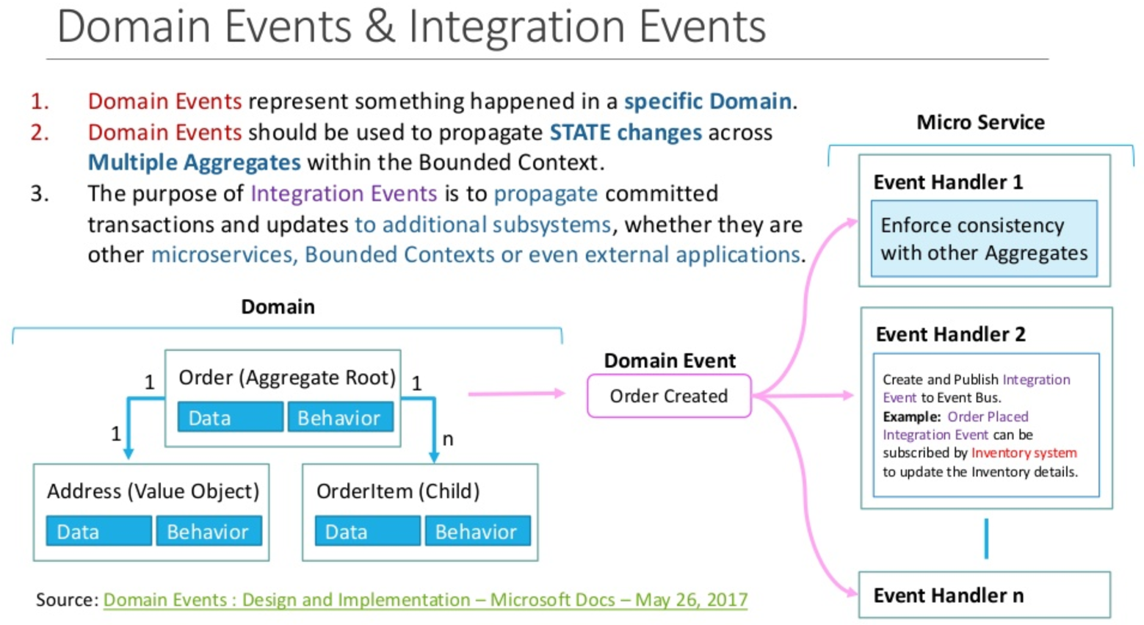
Domain Events & Integration Events

Slide 34
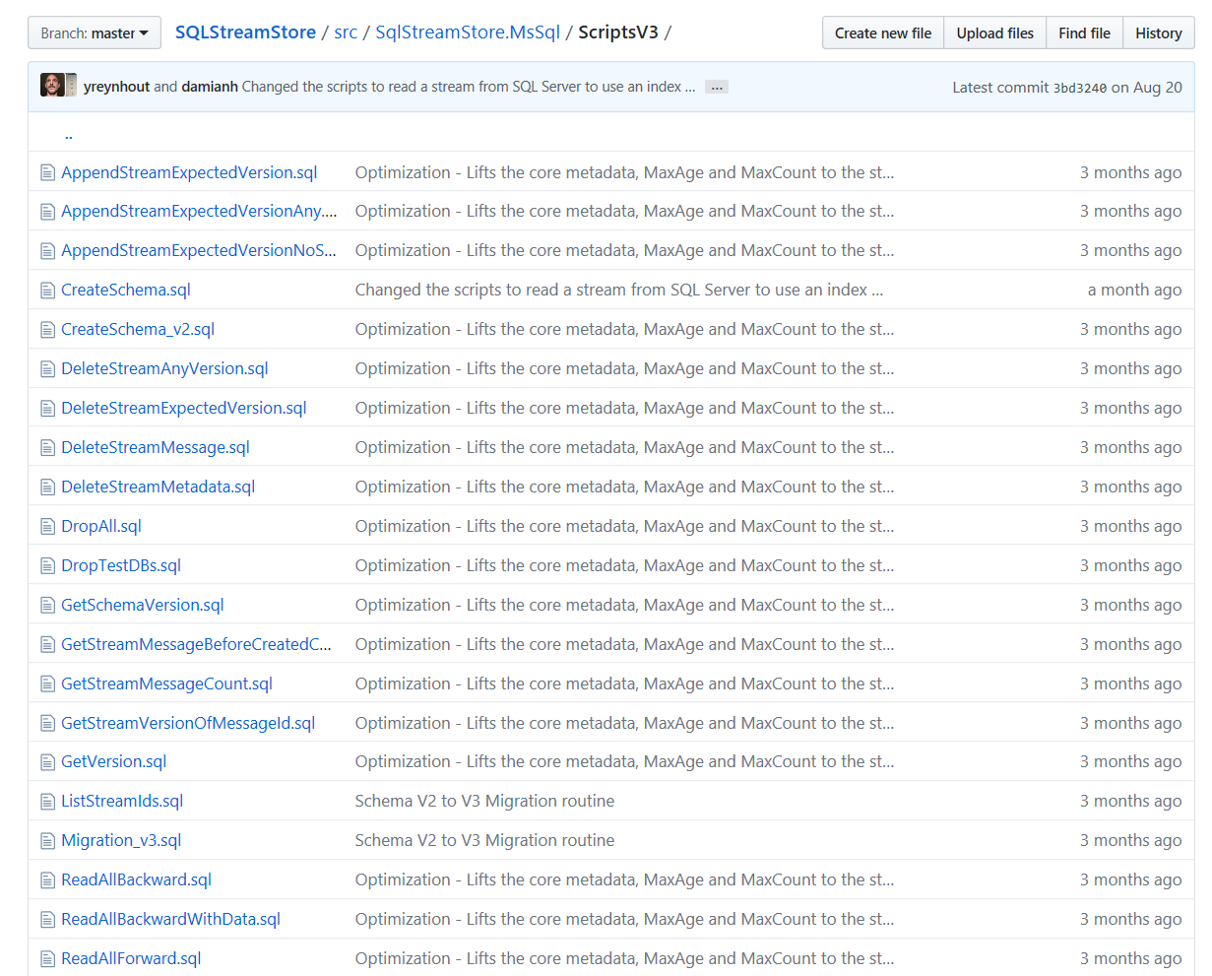

Slide 35
Advantages of append-only streams of immutable events
• Loose coupling. If you write data to the database in the same schema as you use for reading, you have tight coupling between the part of the application doing the writing and the part doing the reading. We know that loose coupling is a good design principle for software. By separating the form in which you write and read data, and by explicitly translating from one to the other, you get much looser coupling between different parts of your application.
• Read and write performance. The decades-old debate over normalization (faster writes) vs. denormalization (faster reads) exists only because of the assumption that writes and reads use the same schema. If you separate the two, you can have fast writes and fast reads.
• Event streams are great for scalability, because they are a simple abstraction (comparatively easy to parallelize and scale across multiple machines), and because they allow you to decompose your application into producers and consumers of streams (which can operate independently, and can take advantage of more parallelism in hardware).
• Flexibility and agility. Raw events are so simple and obvious that a “schema migration” doesn’t really make sense (you may just add a new field from time to time, but you don’t usually need to rewrite historic data into a new format). On the other hand, the ways in which you want to present data to users are much more complex, and may be continually changing. If you have an explicit translation process between the source of truth and the caches that you read from, you can experiment with new user interfaces by just building new caches using new logic, running the new system in parallel with the old one, gradually moving people over from the old system, and then discarding the old system (or reverting to the old system if the new one didn’t work). Such flexibility is incredibly liberating.
• error scenarios are much easier to reason about if data is immutable. If something goes wrong in your system, you can always replay events in the same order, and reconstruct exactly what happened (especially important in finance, where auditability is crucial). If you deploy buggy code that writes bad data to a database, you can just re-run it after you fixed the bug, and thus correct the outputs. Those things are not possible if your database writes are destructive.

Slide 36
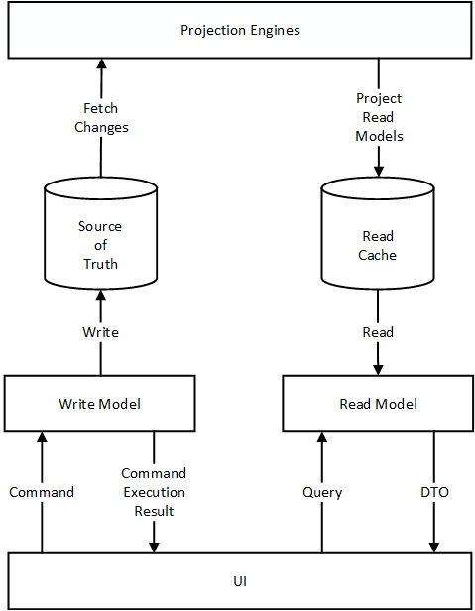
CQRS
ES needs CQRS
CQRS doesn’t need ES

